Slide 1


CODEMAKERS Cotham 2023
Roussel, Joe, Liv, Paul, Umad, Anss
Outreach Team – Faculty of Engineering

Slide 2

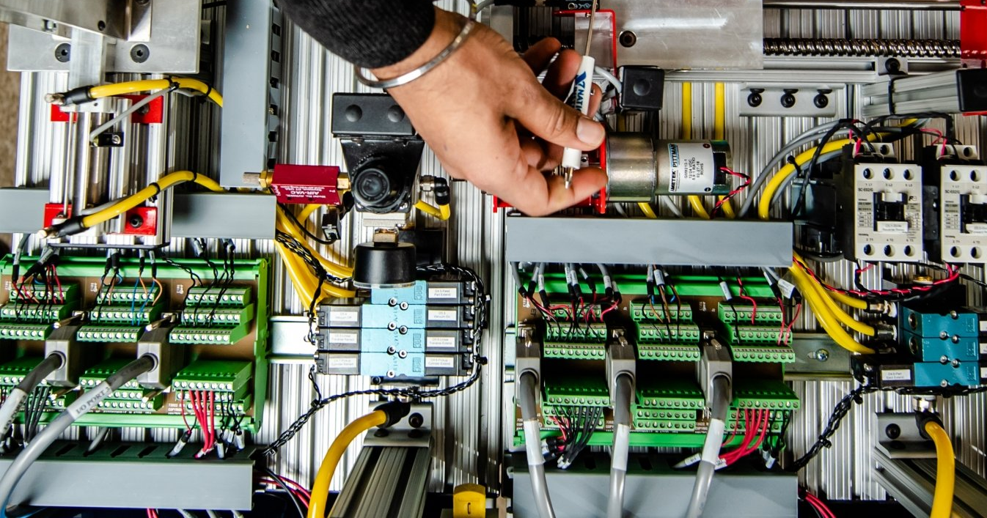


Engineering is problem-solving

Slide 3


What is skeTch ?
A computer software
For images / animations
What is something you would like to build ?

Slide 4

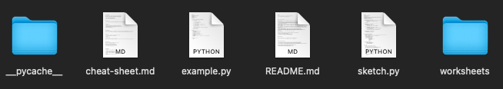
How to access the project folder
On your PC
Go to This PC → Examples → ICT → _Computing → Python → ks3-project-main
Right click on the ks3-project-main folder, and left click copy
Go into the Documents folder
Left click paste
In your browser
Write in the address bar:
github.com/ddrous/ks3-project

Slide 5
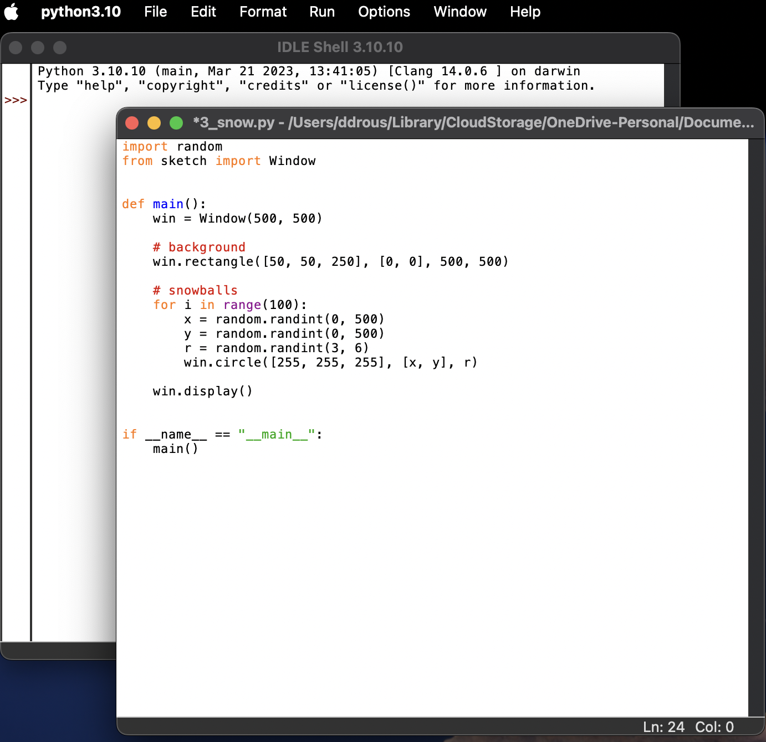
HOW to run a python program
Launch IDLE
Go to File
Create/open an example file
Write code
Click Run

Slide 6
Python basics
Who among you has never used a calculator ?
A variable can store:
a number: x = 10
a character: letter = “b”
a color: red = [255, 0, 0]
a point: Corner = [100, 100]
lots of other things …
How many points do I need to draw a rectangle ?
Give instructions: username = input("Enter username:")
Receive instructions: print("Username is: " + username)
More in the cheat-sheet:
https://www.w3schools.com/python/
https://www.tutorialspoint.com/python/

Slide 7

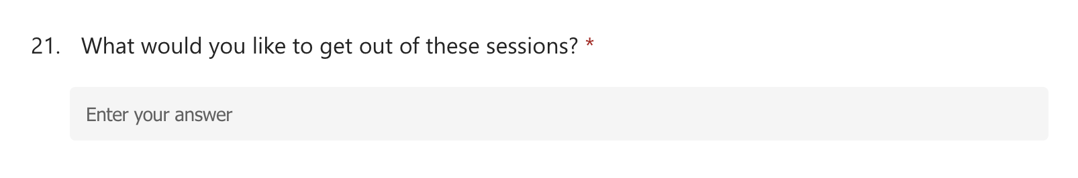
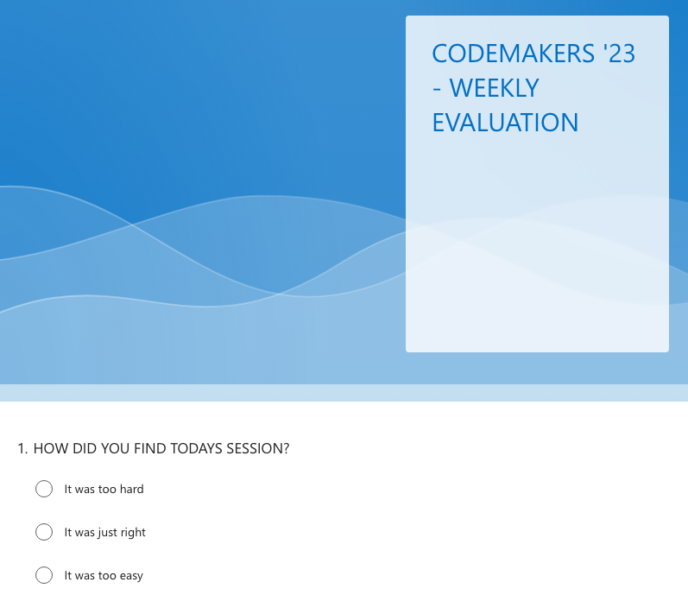
For today
1) You’ve met us !
2) You know about Sketch !
3) Get to coding
ks3-project/sketch/cheat-sheet.md
ks3-project/sketch/worksheets/1_images/book1-shapes.md
4) Help us fill some forms
https://forms.office.com/e/LrqDfNjYtD
https://forms.office.com/e/XRcZ3SJcii

Slide 8
Thank you !
https://github.com/ddrous/ks3-project
☺

Slide 9
CODEMAKERS 2nd session
Roussel, Joe, Liv, Paul, Umad, Anss
Outreach Team – Faculty of Engineering

Slide 10
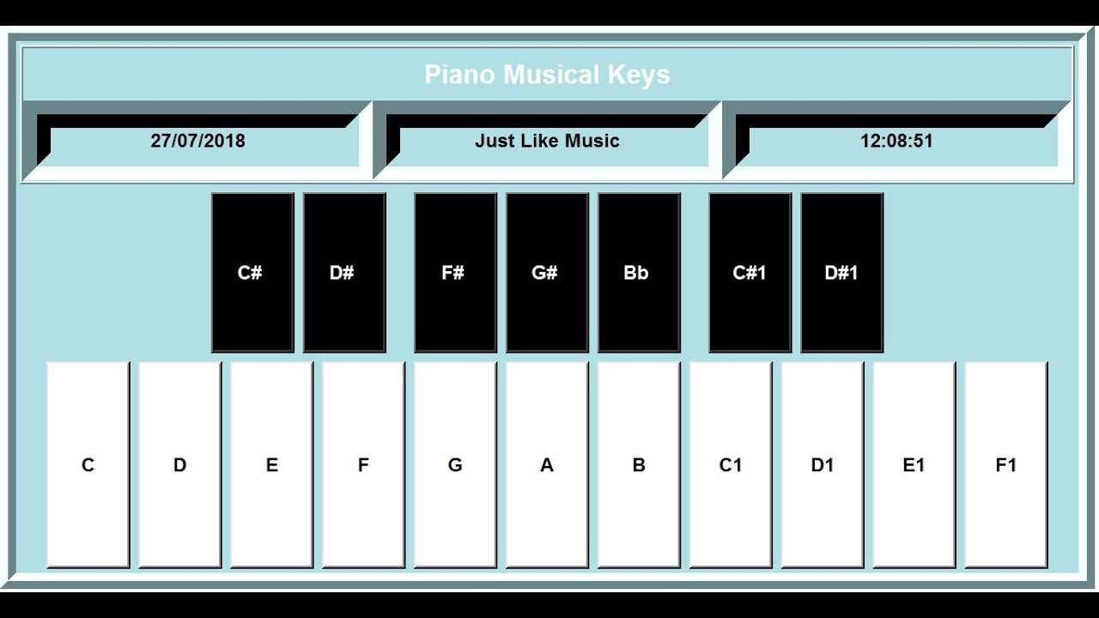
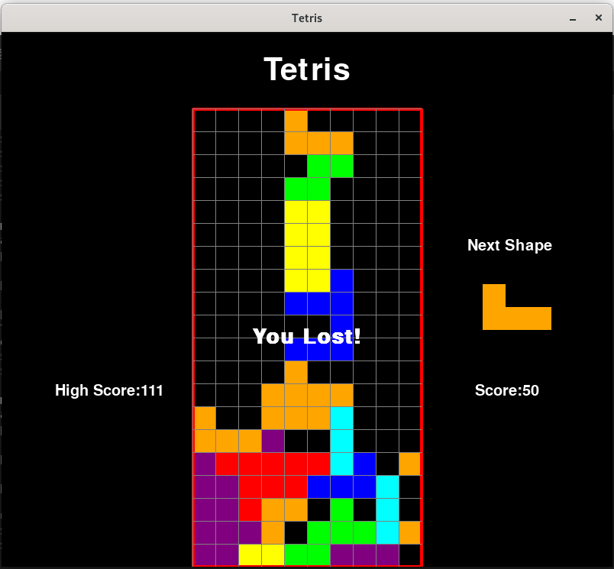
what do you want to build ?
Piano, from https://www.youtube.com/watch?v=l6a9yLb1wiE
Tetris, from https://github.com/vertinski/tetris_game

Slide 11
What is a variable ?
5
To see the content of the box, you write:
my_var
print("The current value is:”, my_var)
“roussel”
You can give instructions to the computer.
[255, 0, 0]
my_var = input("Enter username:")
print("Username is: " + my_var)
Window(500, 500)

Slide 12
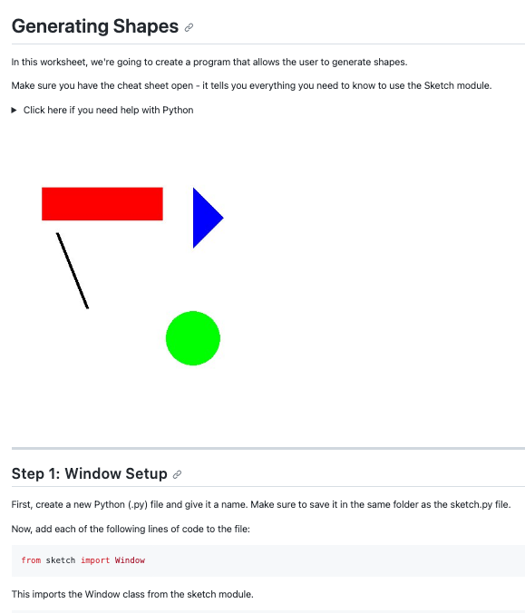
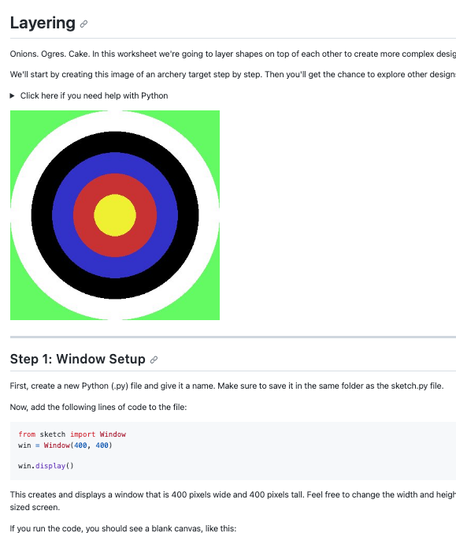
Two worksheets for you today
sketch/worksheets/1_images/book1-shapes.md
sketch/worksheets/1_images/book2-layering.md

Slide 13
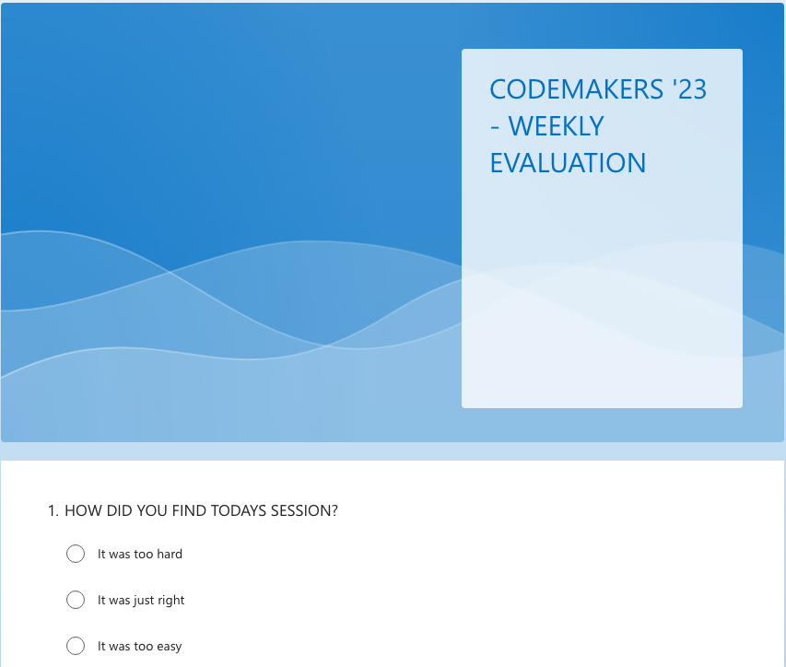
Your feedback was amazing !
We enjoyed reading your feedback to the first session.
Please help us fill it again: https://forms.office.com/e/XRcZ3SJcii
Have your cheat-sheets ready !
Questions before we begin ?

Slide 14
CODEMAKERS 3rd session
Roussel, Joe, Liv, Paul, Umad, Anss
Outreach Team – Faculty of Engineering

Slide 15
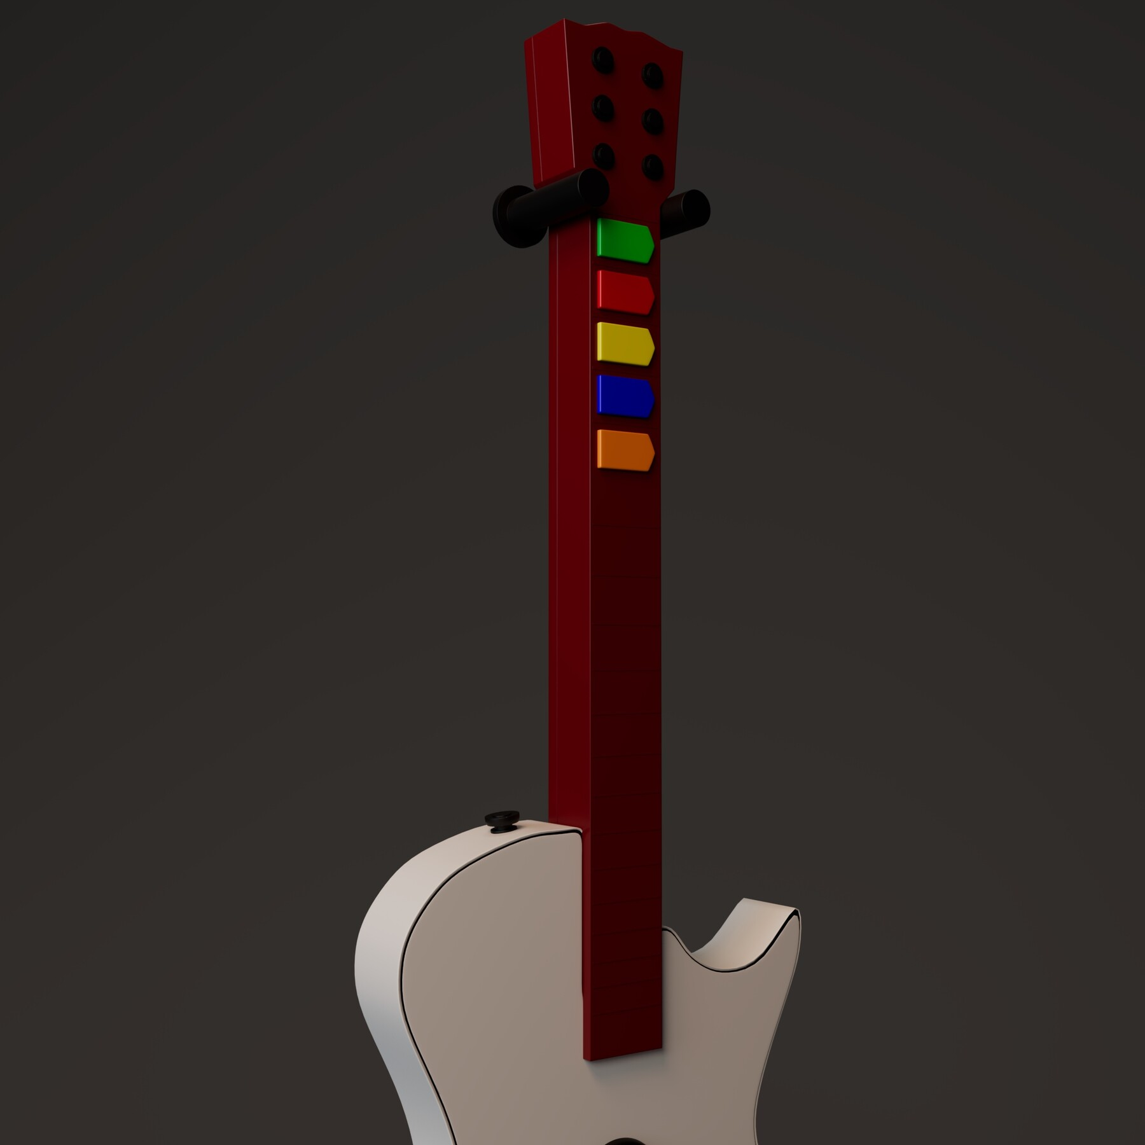
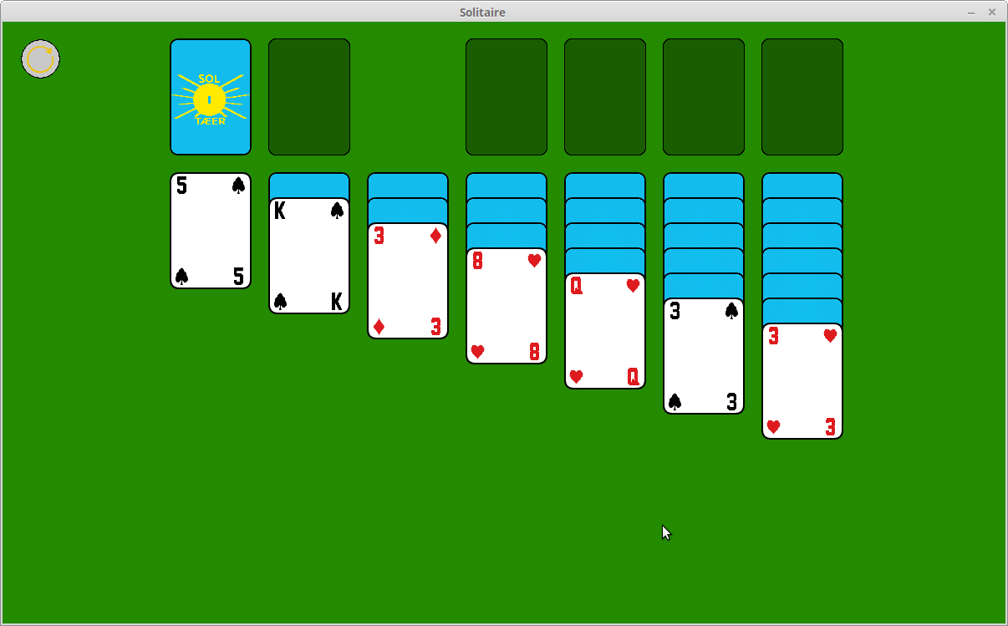
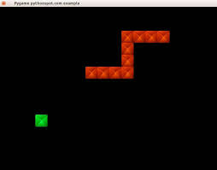
what do you want to build ?
Guitar
Tetris
Anything else ?
Solitaire
Snake

Slide 16
for loops
for x in range(2, 30, 3): print(x)
A for loop is used for go through a sequence.
Learn more here: https://www.w3schools.com/python/python_for_loops.asp
2 5 8 11 14 17 20 23 26 29
fruits = ["apple", "banana", "cherry"] for x in fruits: print(x)
apple banana cherry

Slide 17
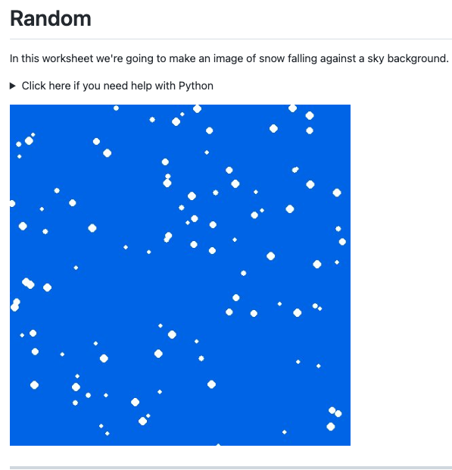
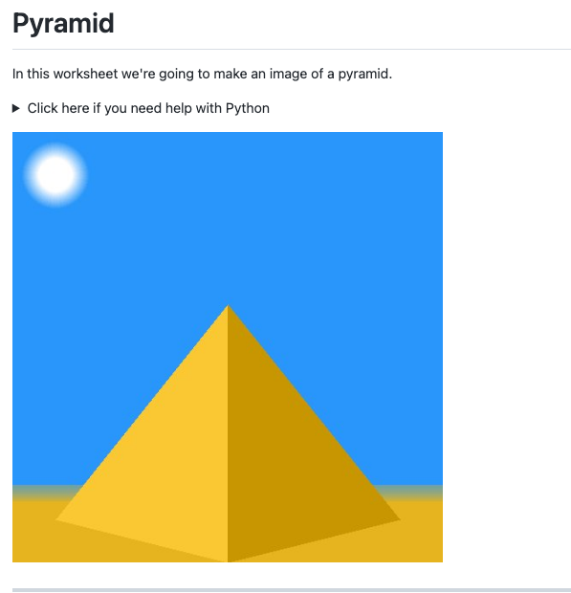
Two worksheets for you today
sketch/worksheets/1_images/book3-random.md
sketch/worksheets/1_images/book4-pyramid.md

Slide 18
Your feedback was amazing !
We enjoyed reading your feedback to the first session.
Please help us fill it again:
https://bit.ly/codemakers2023
https://bit.ly/codemakersweekly
Have your cheat-sheets ready !
Questions before we begin ?

Slide 19
CODEMAKERS 4th session
Roussel, Joe, Liv, Paul, Umad, Anss
Outreach Team – Faculty of Engineering

Slide 20
No new worksheet today
Let’s review what we’ve seen so far.
Have your cheat-sheets ready !
We love your feedback:
https://bit.ly/codemakersweekly
Questions before we begin ?

Slide 21
CODEMAKERS 5th session
Roussel, Liv, Umad, Anss, Nasma
Outreach Team – Faculty of Engineering

Slide 22
what do you want to build ?
Guitar
Tetris
Anything else ?
Solitaire
Snake

Slide 23
for loops
for x in range(2, 30, 3): print(x)
A for loop is used for go through a sequence.
Learn more here: https://www.w3schools.com/python/python_for_loops.asp
2 5 8 11 14 17 20 23 26 29
fruits = ["apple", "banana", "cherry"] for x in fruits: print(x)
apple banana cherry

Slide 24
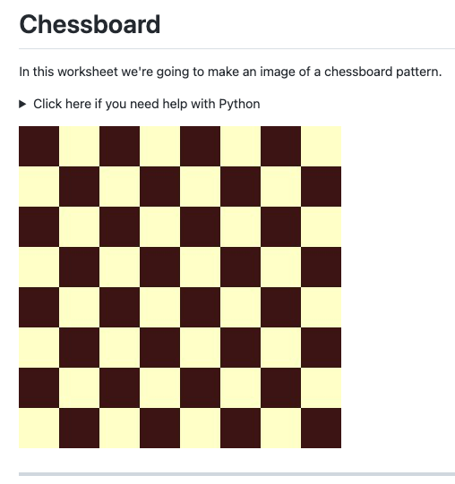
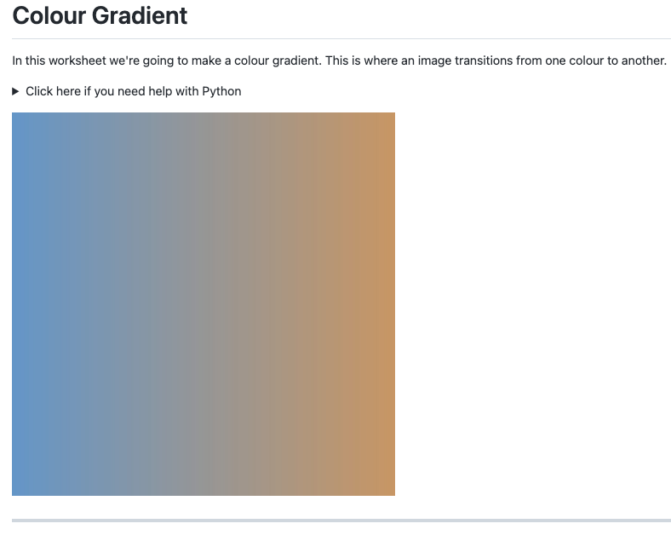
Two worksheets for you today
sketch/worksheets/1_images/book5-chessboard.md
sketch/worksheets/1_images/book6-gradients.md

Slide 25
Your feedback was amazing !
We always enjoy reading your feedback.
Help us fill it the forms:
https://bit.ly/codemakers2023 🚨
https://bit.ly/codemakersweekly
Have your cheat-sheets ready !
Questions before we begin ?

Slide 26
CODEMAKERS 6th session
Roussel, Liv, Umad, Anss, Nasma
Outreach Team – Faculty of Engineering

Slide 27

what Can YOU do with images ?
Guitar
Tetris
Solitaire
Snake

Slide 28



We can do more with animations

Slide 29
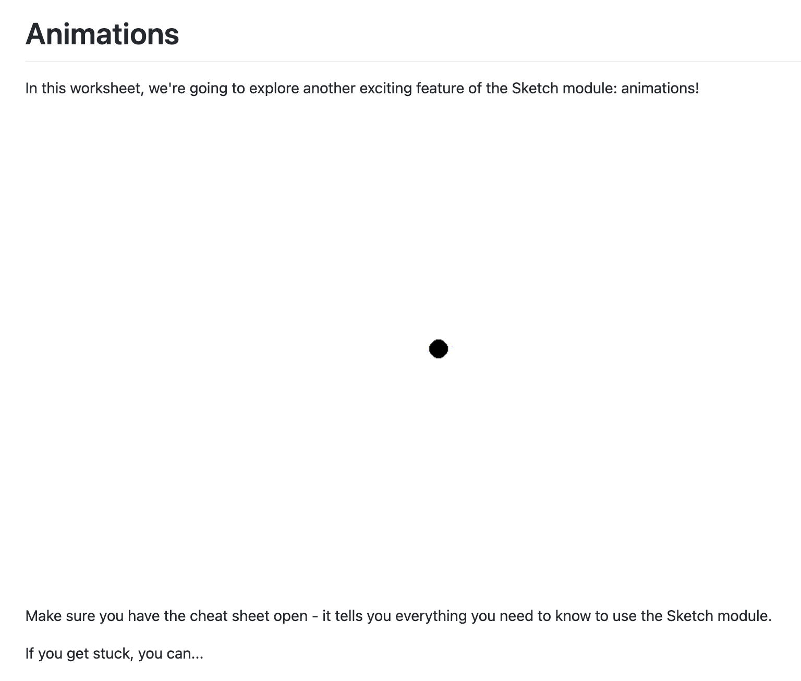

One worksheet for you today
sketch/worksheets/2_animations/book7-animations.md

Slide 30
Your feedback
We always enjoy reading your feedback.
Help us fill in the forms:
https://bit.ly/codemakersweekly
Have your cheat-sheets ready !
Questions before we begin ?

Slide 31
CODEMAKERS 9th session
Roussel, Liv, Umad, Anss, Nasma
Outreach Team – Faculty of Engineering

Slide 32
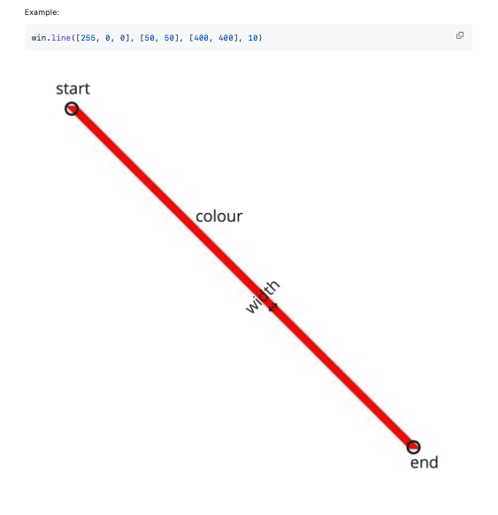
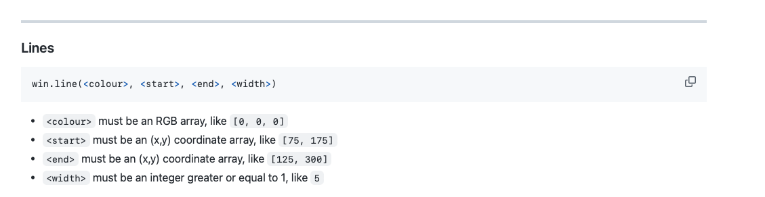
The cheat sheet

Slide 33
One worksheet for you today
Step 1: Window Setup
Step 2: Initialise the Snow
snow_balls = [[8, 200],
[367, 500],
[327, 399],
...
[61, 467]]
Step 3: Drawing the Snow
Remember to clear the screen.
Step 4: Regenerating the Snow
Step 5: Size Variation
Step 6: Speed Variation
sketch/worksheets/2_animations/book10-falling-snow.md

Slide 34
Your feedback
We always enjoy reading your feedback.
Help us fill in the forms:
https://bit.ly/codemakersweekly
Have your cheat-sheets ready !
Questions before we begin ?

Slide 35

CODEMAKERS 10th session
Roussel, Liv, Anss
Outreach Team – Faculty of Engineering

Slide 36

One worksheet for you today
Step 1: Window Setup
Step 2: Static clock
We need: - A brown rectangle - A white circle - Black lines
Step 3: Find the coordinates
We need trigonometry.
Step 4: Move the hands
We use next_frame().
sketch/worksheets/2_animations/book11-clock.md

Slide 37
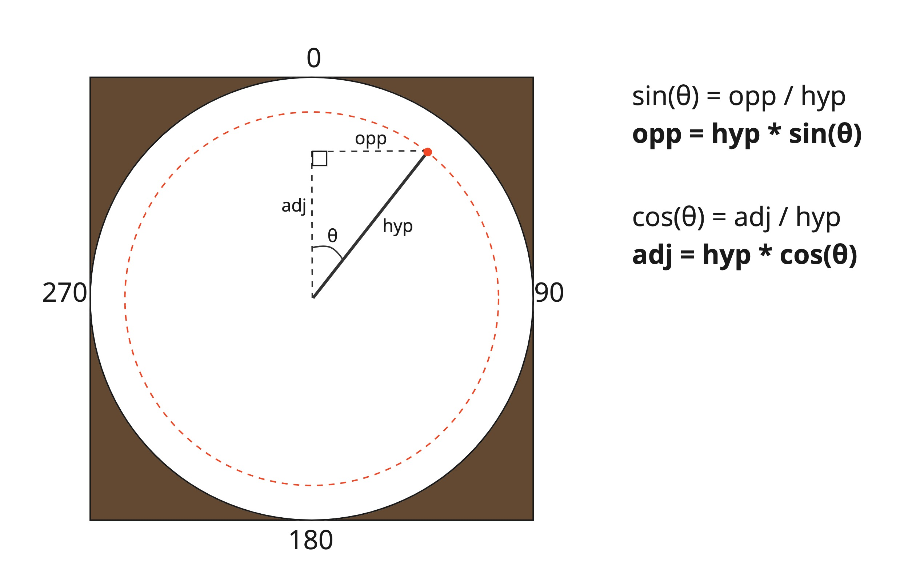
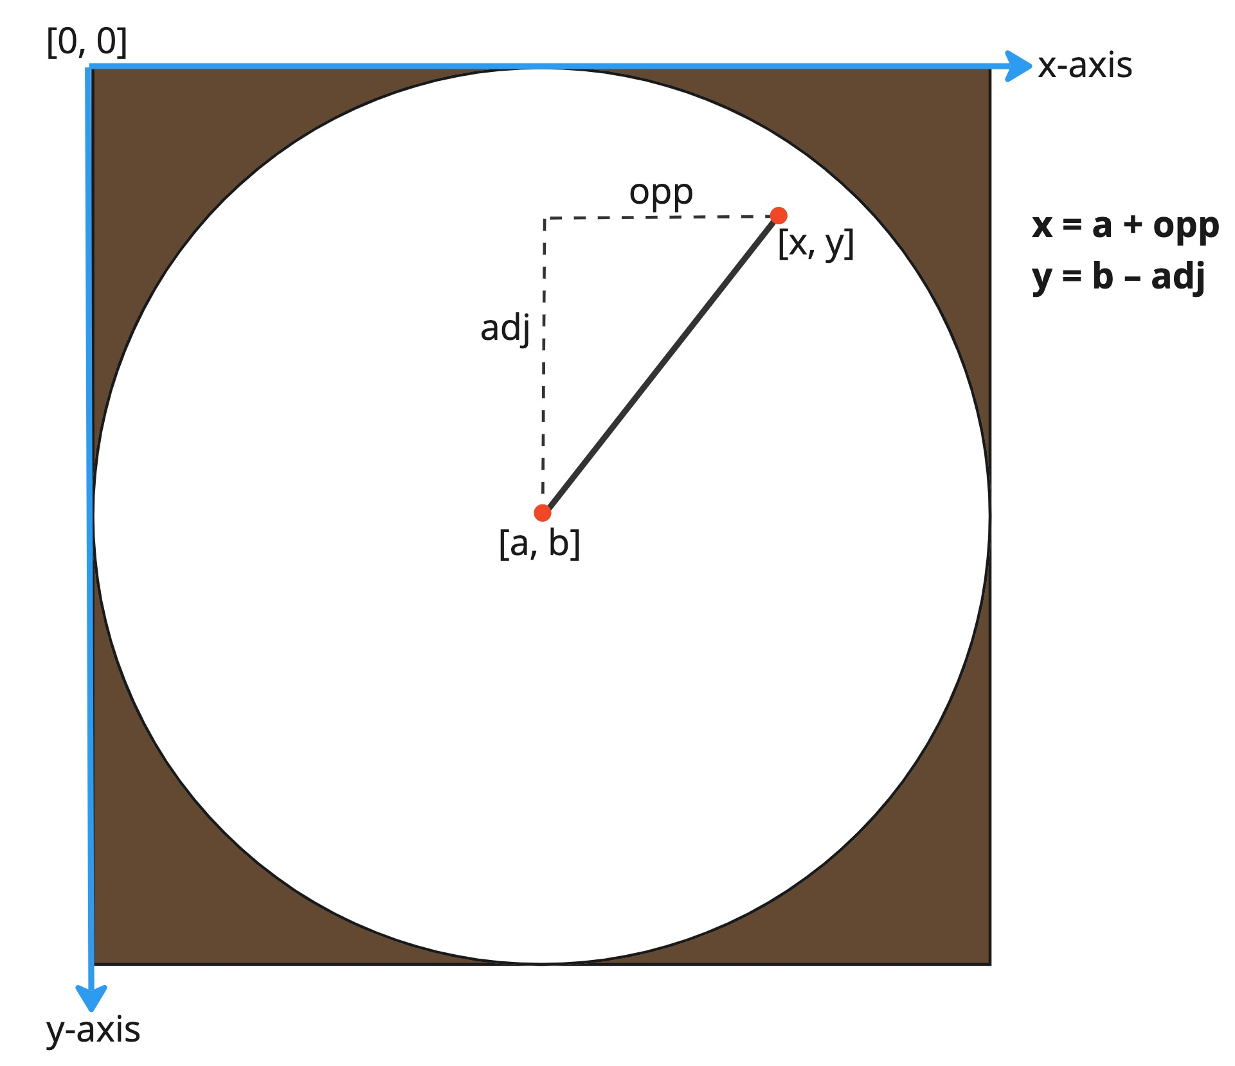
Animate using trigonometry

Slide 38
Your feedback
We always enjoy reading your feedback.
Help us fill in the forms:
https://bit.ly/codemakersweekly
Have your cheat-sheets ready !
Questions before we begin ?

Slide 39
CODEMAKERS 11th session
Roussel, Umad, Anss, Nasma
Outreach Team – Faculty of Engineering

Slide 40

For today
No new worksheet !
Tell us :
about you
about your project
what you learned
how you will use these skills

Slide 42
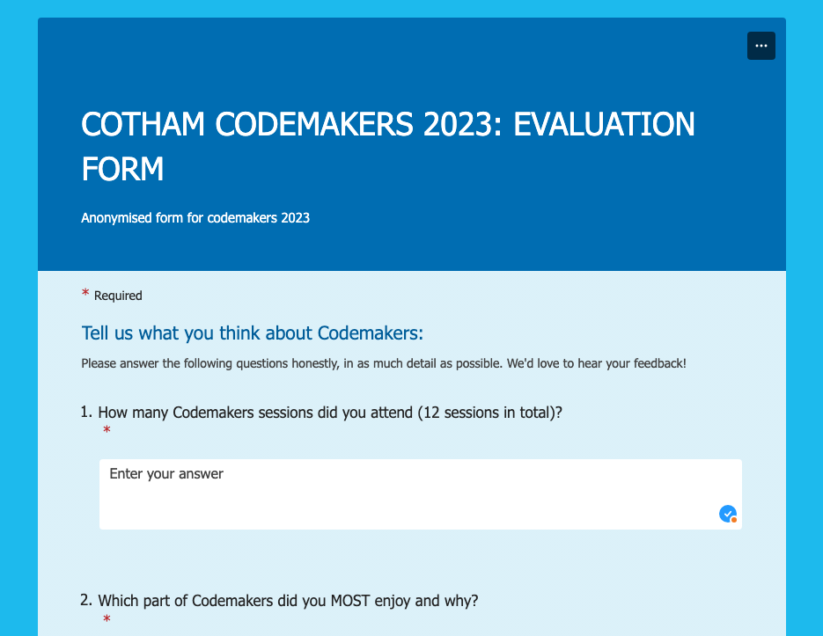
Your feedback
We always enjoy reading your feedback.
Fill the final evaluation form:
https://forms.office.com/e/n83U4WZK5X
Have your cheat-sheets ready !
Questions before we begin ?

